Slide 1




Final Report Tips
FY2026

Slide 2
Final Invoice
  Final Invoice
  NM Arts Contract Award Amount (Populated on Form)
  Enter Amount Requested this Invoice
  Enter Total Previously Requested
  NM Arts Contract Amount Remaining should be zero ($0.00).
  *Please use whole numbers.
Itemized Invoice
  List dollar amounts on appropriate line items for the current invoice.
  Amounts by line item should be the amount of New Mexico Arts funds spent for this invoice and not your total expenditures.
  If you are only submitting a Final Invoice, the line items listed here should match your Final Fiscal Report (FFR).

Slide 3
Final Fiscal Report
  List the Actual Income and Expenses for your funded program(s).
  The line-item totals in your FFR must match the total of all submitted invoices by line item.
  Download the Final Fiscal Report (FFR) , enter your data, save, and upload the file. See Manage Your Grant
  Name your uploaded file: YourOrganizationName_FFR
  FFR figures should align with your Final Narrative & Program Data., i.e. Private Support corresponds though is not limited to Volunteer Data in questions 14a & 14b, and Salaries and Benefits correspond to Staff Data questions 15a & 16b.

Slide 4
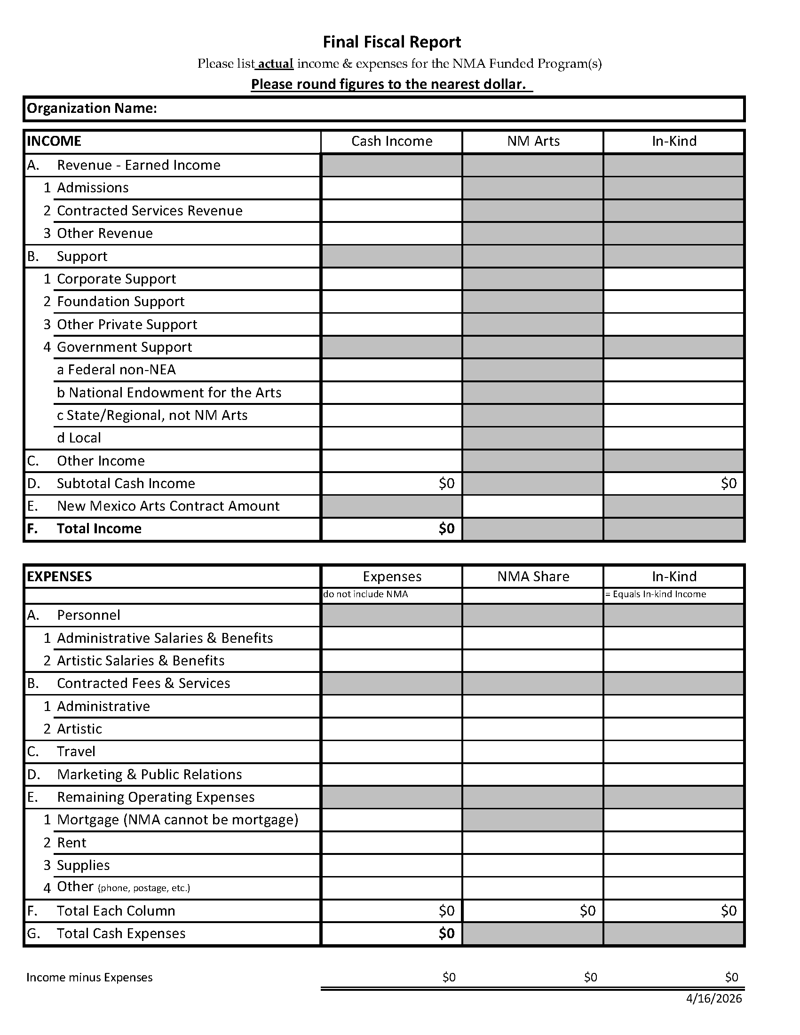
Enter Organization Name
Column 1, enter Total Cash Income and Total Cash Expenses for the funded program.
Column 2, enter the New Mexico Arts Contract Amount listed in your grant agreement. Enter the NMA Share for Expenses and ensure the figures listed match all itemized expenses listed in your invoices.
Column 3, enter the In-Kind Income and In-Kind Expenses for the funded program.
Include a 50% match for the funded program at least half of which must be cash.
See Budget-Detail-Tips.pdf for guidance.
FFR Bottom Line Clarification
Last Line on FFR - Income minus Expense (Column 1 Income less Expenses does not have to be zero) (Column 2 NMA Share and Column 3 In-Kind should be zero)

Slide 5
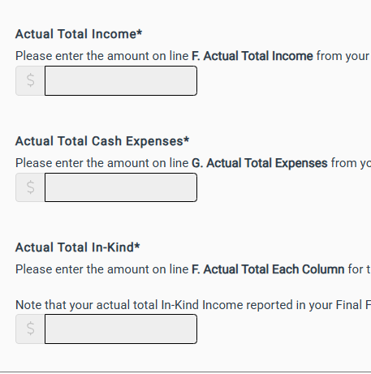
Actual Total Income* must match figure listed on FFR.
Actual Total Cash Expenses* must match figure listed on FFR
Actual Total In-Kind*must match figure listed on FFR

Slide 6
Expenses
Personnel Expenses
List all administrative and artistic personnel costs for the funded program.
Administrative Salaries and Benefits: All paid full- or part-time W2 salaried employees.
Artistic Salaries and Benefits: all paid full or part-time W-2 salaried employees.
Contracted Fees & Services
List all contracted fees and services related to the funded program.
Administrative Contracted Fees and Services: Includes consultants, accountants, secretarial support, a contracted project director (1099 contractors)
Artistic Contracted Fees and Services: Includes artists, actors, printers, designers, etc. (1099 contractors)
If you list Full-Time and/or Part-Time Employees under Program Data, you will have figures for Administrative and/or Artistic Salaries in the Cash and/or NMA Share Column(s).
15a. Staff Data: Full-Time Employees How many full-time employees worked on your funded programs and services? If none enter 0.
16a. Staff Data: Part-Time Employees* How many part-time employees worked on your funded programs and services? If none enter 0.

Slide 7
In-Kind
Please list Total In-Kind for the funded program; this includes goods or services provided to an organization at no charge or at a reduced rate. In-Kind may be used towards the required match.
Any in-kind listed as income should also be listed as expenses on the appropriate expense line item. In-kind income must equal in-kind expenses.
How do you calculate In-Kind?
Volunteer Hours are listed as (other private support) and are calculated at current market wages, at least the federal minimum wage (7.25/hr.) unless the volunteer is donating professional services, which are calculated at professional rates and should be listed as “Corporate support.” See volunteer hours in Program Data.
Donated materials and donated space (rental) directly involved with the proposed program should be calculated at fair market value.
*Do not include board members’ usual duties such as board meetings, organizational retreats, and committee meetings as in-kind support.

Slide 8
In-Kind Income
List the In-Kind support for the funded program including, but not limited to:
Corporate Support: Contributed goods/services from businesses.
Other Private Support: Contribution of individuals which may include volunteer hours for funded activities.
Government Support: may include in-kind support from a government entity.
In-Kind Expense
List the In-Kind support for the funded program, determine the nature of the contribution including, but not limited to:
Contracted Fees and Services
Administrative: Duties being performed at no cost or a discounted rate.
Artistic: Artists donating all or a portion of their time
*In-Kind Revenue should equal In-Kind Expense.
1500
7500
1500
10,500
3750
3750
1500
1500
10500

Slide 9
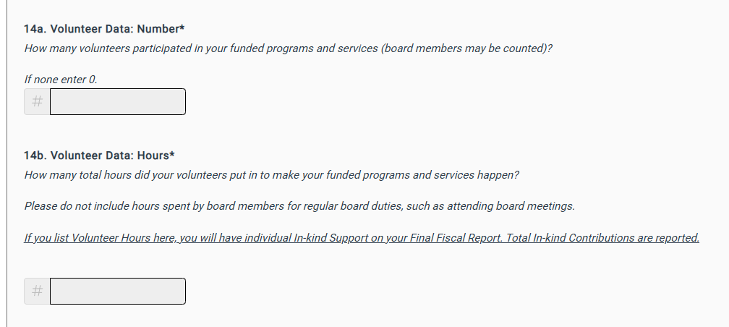
Align FFR & Volunteer Data
Program Data: Volunteer Data
14a. How many volunteers participated in your funded programs and services (board members may be counted)?
14b. How many total hours did your volunteers put in to make your funded programs and services happen?
If you list Volunteer Hours under Volunteer Data, this is counted towards (Other Private Support) on your Final Fiscal Report.
1500
7500
1500
10,500
3750
3750
1500
7500
1500
10500

Slide 10
Final Narrative
Please describe the New Mexico Arts-funded programs and services as outlined in your Schedule of Programs and Services in your Grant Agreement –See Executed Grant Agreement.
If the programs didn't happen as planned, please discuss in your narrative and describe any program changes in your narrative.
Please include only the funded programs and services; do not include activities outside of your grant period or activities that are subject to funding restrictions.
Notes:
Re word for Organizations

Slide 11
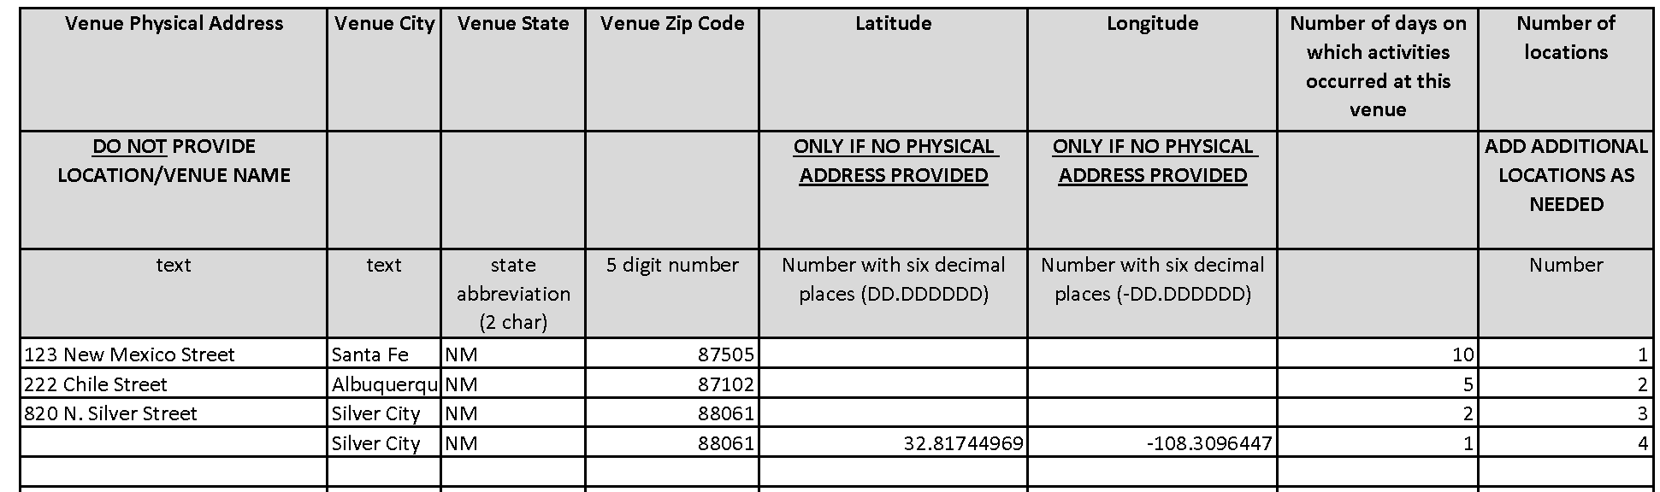



Project Activity Location
The PAL captures geographic information for your funded projects only.
Download the Project Activity Location (PAL) Form, enter your location data, save, and upload the file.
Number each location in the last column.
Please name your file: YourOrganizationName_PAL
Make sure that counties served reflected in Program Data align with cities listed on the PAL.

Slide 12
Program Data
Select the answers that best apply to your funded programs and services. Refer to your last submitted Final Report to assist with appropriate selections.
ADA Compliance
These are organization-based questions that extend beyond funded programs. Please provide information regarding the accessibility of your programming.

